Slide 1
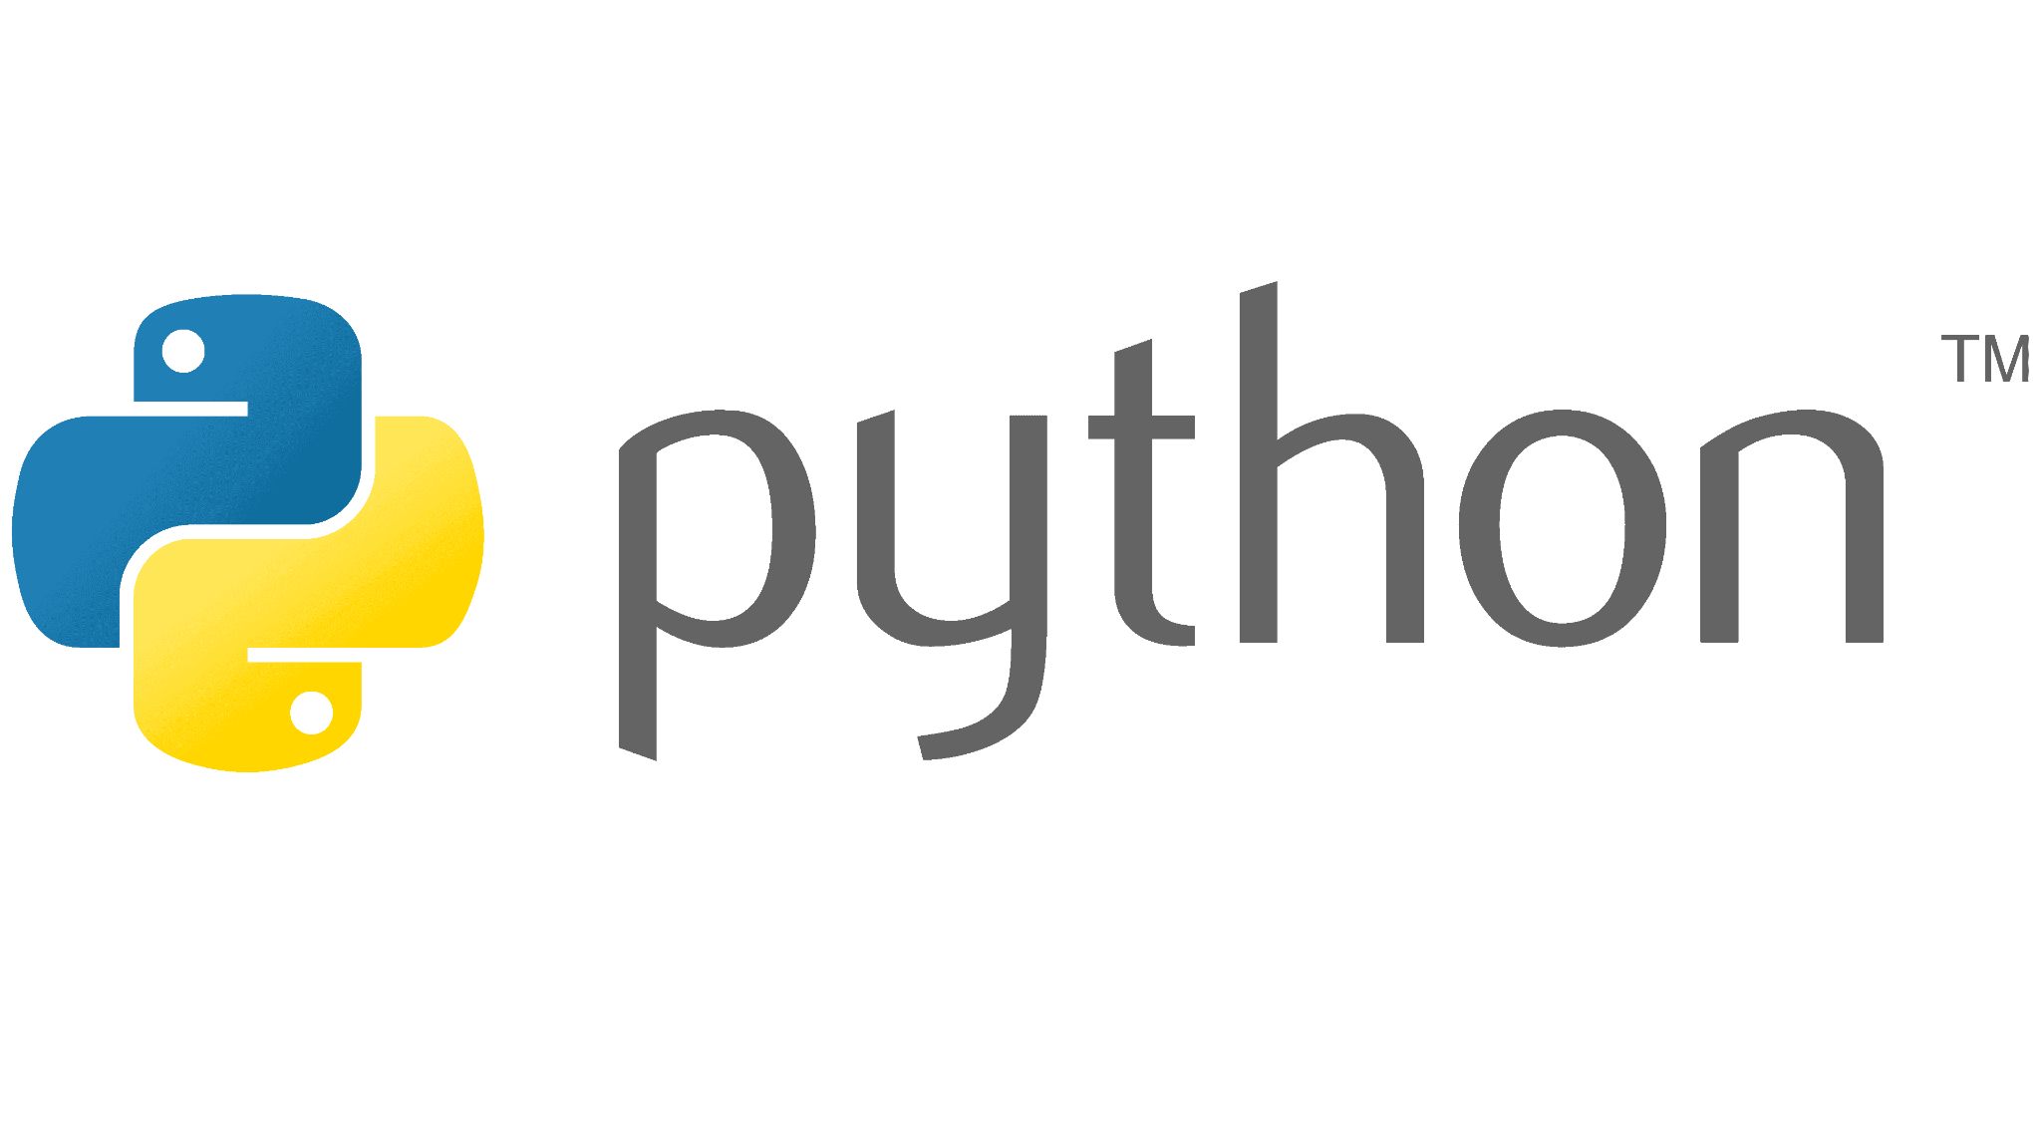


Slide 2

Last lecture reminder
We learned about:
What are loops in Python
Different types of loops:
for loop
while loop
Using loops to iterate on different data structures
Nested loops and how to use them for iterating a matrix

Slide 3


Slide 4
Introduction to datetime() Python module
In most of our day to day websites we can see a lot of work around time and date. Meaning most of our collecting data that is coming from those websites will involve dates.
Here some examples for date object usage while collecting data:
Dates when a specific product is available in stock
The publish date of specific comment or review by customers
In a news website - the time the article was created
As you can see, working with time and date is a big part from our work as AI developers

Slide 5
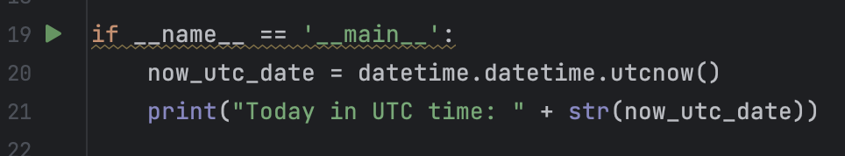
Using datetime object
Python allow us to work with dates by using the datetime object.
The datetime object has its own properties and methods that allow us to add basic operations with date and time.
The datetime object has the ability to show the date and time according to the country local time and in UTC timezone which is the universal timezone.

Slide 6
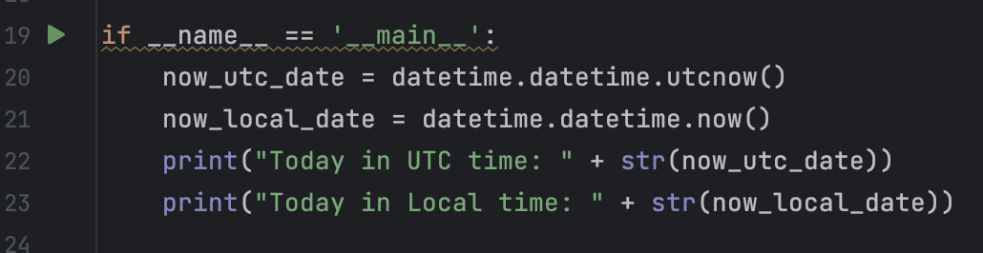

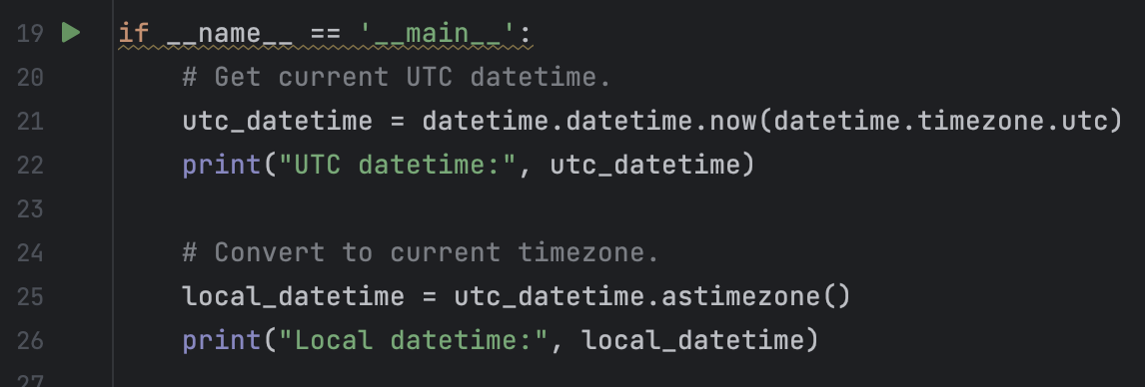
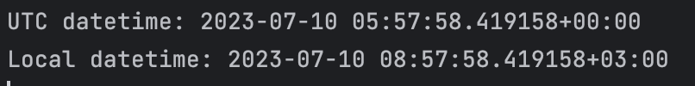
Using datetime object
Python datetime module also allow us to create local datetime instance using now() method
If we will want to convert date from UTC timezone to local timezone we do it by using the astimezone() method

Slide 7
datetime module useful methods
date() → Will return us only the date itself without the time
time() → Will return us only the time itself without the date
year() → Will return the date year number
month() → Will return the date month number (1 - Jan, 12 - Dec)
day() → Will return the date day number (1 - 31)
hour() → Will return the time hour number
minute() → Will return the time minute number
second() → Will return the time second number

Slide 8
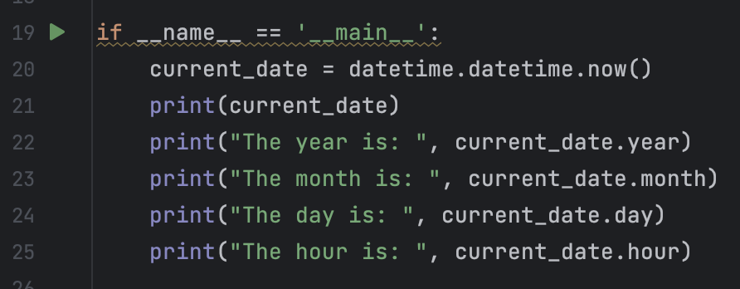
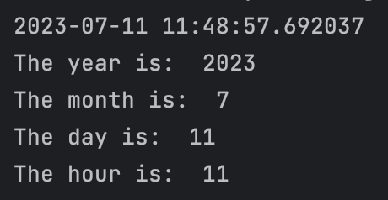
Date() object methods - example
year() - return the year number (2023) month() - return the month number (July) day() - return the day number (11)
hour() - return the hour number (1)

Slide 9
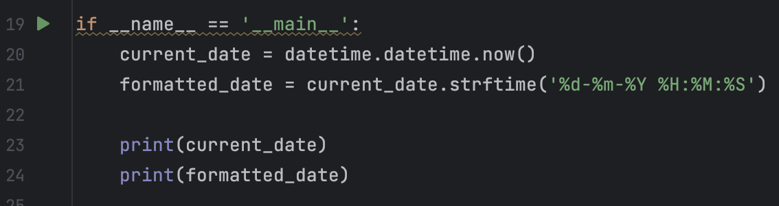
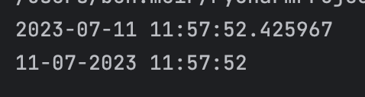
Formatting Dates & Time
In some cases we will want to change the date and time format. In order to do that we can use strftime() method. The strftime() method gets a string that represent a valid date-time format and transfer the datetime object according to the format provided.
When writing code that involve Data & Time logic we should choose the best data/time format that will fit our needs.
Using dd-mm-YYYY format for the Date and HH:MM:SS for the Time

Slide 10
Introduction to Math Python module
In some case we will want to perform mathematical tasks on numbers. For that use case Python provide us the Math module.
The most common tasks we will want to achieve using the Math module are:
Round a number to its nearest integer down
Round a number to its nearest integer up
Generate a random number between a specific range

Slide 11
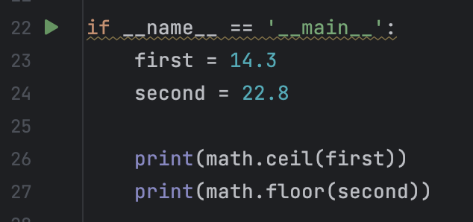

Import and using Math module
In order to use the math module in our Python program, we first need to import it.
Once we successfully import the module, we can use its methods to perform math operation in our program.
Note: The random() method is not part of the math module but its associated to different Python module called random.
For example:
By using the math module and the ceil() method we round the number up By using the floor() method we can round the number down

Slide 12
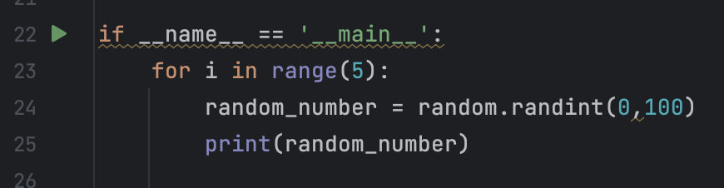

random Python module - example
The random module allow us to generate random numbers between given range. The randint() function will get 2 numbers as parameters - first is the random low range and the second is the large random range. Once executed, the function will return a random number (as int) between the given range.
Generate a random number between 0 to 100 according to the given range and return it as int

Slide 13

Class Exercise - Python Dates & Random
Instructions:
On your existing Python project create a new Python file and call it “PythonMath”.
Create a main() method.
Inside the main() method create 2 variables that save a random number between 1 - 5
write a condition that check if the two numbers are equal, if they are → print “The numbers are equals with value: {random number}” if they not → print “The numbers are not equals, first number value is: {first random number}, and second number value is: {second random number}
Print the current date and time with this format -

Slide 14
Class Exercise Solution - Python Dates & Random

Slide 15
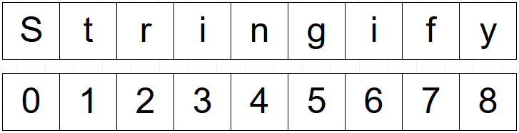
Python Strings
In Python, String variables are not primitive but on Object, which mean they have default properties and methods that we can use.
String variables in Python are used for storing text. Reminder - String is basically a collection of Chars that are connected together.
We can look at String as an Array of Chars where each Char has its own index inside. And same with arrays, every string has a length property that return its length.

Slide 16
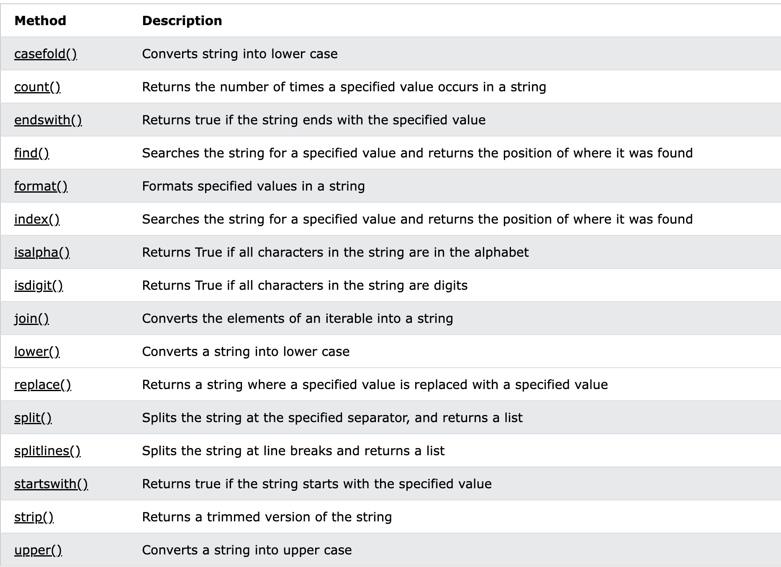
Essential String Methods

Slide 17
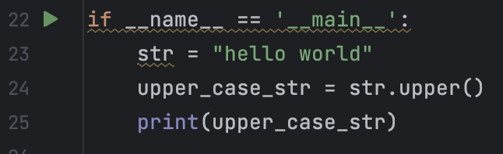

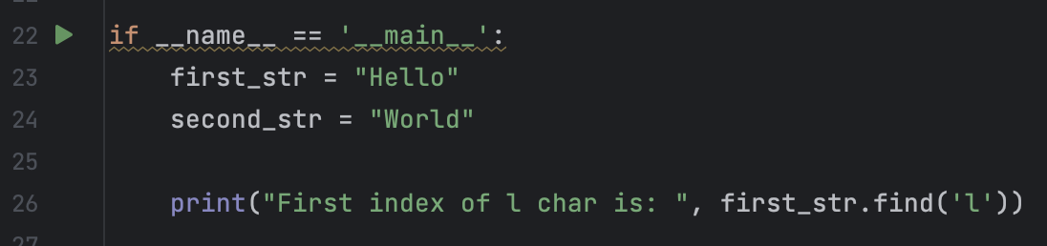

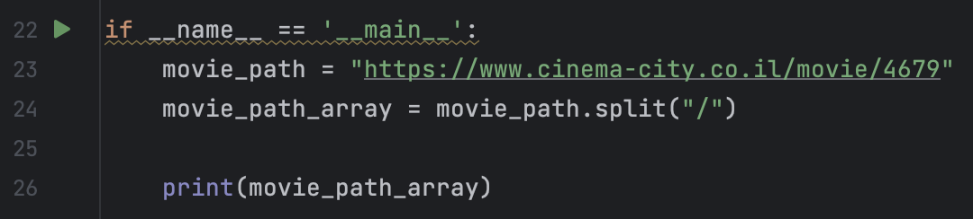
Essential String Methods - Examples
By using the toUpperCase() method we managed to replaced the lower case chars in the string to upper case chars
By using the find() method we can get the index of the first appearance of the provided char

Slide 18
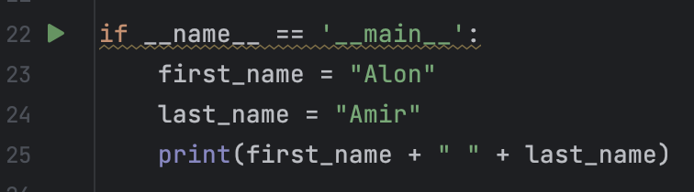
Concatenate Strings
The action of combining strings together is called concatenation. Python String can be concatenate in different ways:
By using the “+” operator:
Note: Python uses the + operator for both addition and concatenation. Numbers are added, Strings are concatenated.
Using the + operator to concatenate strings together

Slide 19
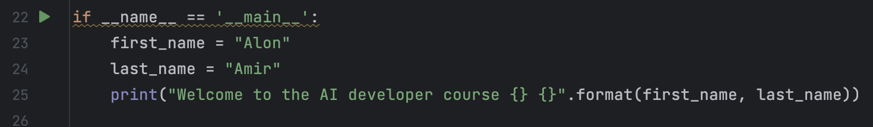
Concatenate Strings
By using the format() method to concatenate unlimited number of strings. In order to use the format() method we need to add {} symbol every place we want to concatenate other variables to it. Python will replace the {} symbol with the variables we provide in the end of the string. Note: the replacement will be in the order of variables we put in the end of the string.
The first {} symbol will be replace at runtime with the first_name variable. The second {} symbol will be replace at runtime with the last_name variable.

Slide 20
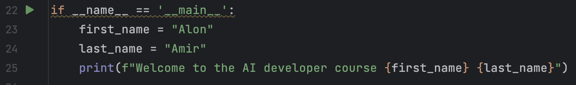
Concatenate Strings
By using the f-string that will create a similar behavior to the format() method. In Python, the `f` before the string is used to denote an f-string, which is a kind of string. f-string allow us to pass the variable string name itself that we want to concat to the f-string.

Slide 21
Class Exercise - Python Strings
Instructions:
Open your Pycharm project and create new Python package called “Python Strings”
Your mission is to implement all the following instructions:
Create a main() method.
Inside the main() method create a new String type variable that save your full name as following: {first name}.{end name} → Ben.Meir
Write a Python program that take this variable and separate the first name from the last name and save it into 2 different String type variables.

Slide 22
Class Exercise - Python Strings
Instructions:
Once you have the 2 variables, print the following sentence by using the format() method: Welcome to the course: your first name is: {$first name} and your last name is: {$last name}
Add to your previous Python program Python code that implements the following:
Take the sentence from the previous exercise and print the index where your last name started at.
Create a function that receive 2 strings If 1 of them is part of the other string → the function will return true If not → the function will return false The check should include lowercase and uppercase

Slide 23
Class Exercise Solution - Python Strings

